Slide 1

COIS 3320: Fundamentals of Operating Systems
Alaadin Addas
Week 10
File Systems

Slide 2
Overview
Announcements/Reminders
Recap
File System
Files
File Directories
Implementations of File Directories
Operations on Files
Summary
Lab 4

Slide 3
Announcements/Reminders
April 2nd is a statutory holiday.
Even though we are learning in an online environment I still cannot hold the lecture and expect you to be there (I asked ☺).
So early on I had two options, either cram the content into unused lab hours, or make it a recorded lecture split into several videos that you can watch. I picked the latter.
Assignment 2 is in the process of being marked and you should have your marks early next week.
Lab 3 is in the process of being marked and you should have your marks next week.
Assignment 3 has been released.
You received feedback on your report proposals already. Make sure you read the feedback.
Remember there are no marks for your proposals but if your proposal was not approved you will not be able to submit the actual report or presentation!

Slide 4
Recap
Last week we discussed the concept of Virtual Memory.
What is Virtual Memory?
Is the virtual memory address space typically larger or smaller than the physical address space?
Why is the LRU page replacement algorithm inefficient in practice.
What alternatives exist to alleviate this problem?
Why is the principle of locality of reference very crucial? What are machines designed to avoid?

Slide 5
Files
What is a file, and why use files at all?
Users have the need to maintain information in persistent storage over extended periods of time.
The most common secondary storage devices are solid state drives, magnetic disks and tapes, which are supplied by many different manufacturers.
The complexity and wide variety of device-specific interfaces makes the management of data directly on the devices impractical for most users.
A file system (FS) is an integral part of every OS, whose function is to implement the concept of files.

Slide 6
Files
A file is a named collection of information managed on secondary storage by the FS.
The user can view a file as a single abstract unit of data storage and access the file's contents using high-level operations provided by the FS's interface, without knowing the specific characteristics of the underlying storage devices.
Depending on the FS, a file can be viewed as an unstructured stream of bytes or a series of records.
A record is a structure of related data items, possibly of different data types, identified within a file by a record number or a unique key field.
For example, A student ID would uniquely distinguish all student records in a file.

Slide 7
File Access Method
An access method is a set of operations provided by the OS as part of the user interface to access files.
The most common access method is sequential.
The FS maintains the current position within the file and each read/write operation accesses the next n bytes or the next record of the file.
Some OSs (Ex: most IBM systems) support also direct access methods, where a record can be accessed directly by specifying a record number or a key value.

Slide 8
File Types
Applications use files to store information on the disk and to pass information from one application to another.
The producer and the consumer of a file must agree on the format of the information within the file.
For example, a compiler expects a file consisting of ASCII characters organized as lines of source code.
The output of the compiler is a file consisting of executable binary code, data, relocation information, and various tables and flags, which must be understood by the linker.

Slide 9
File Types - Metadata
Every file consist of data and metadata.
Data is the portion of the file visible to the file's user.
Metadata is information about the format and organization of a file's data and is generally stored in a file header.
A file header is a portion of the file preceding the actual data and is visible to only the FS itself

Slide 10
File Types – Magic Number
The magic number is a short sequence of characters at the start of the file header, which identifies the file type.
The file type, in turn, determines which programs can access and interpret the file.
For example, the OS will allow only properly compiled and linked binary files to be loaded into memory for execution.

Slide 11
File Types – Extensions
Another way to represent file types is to use file extensions. You are probably more familiar with file extensions.
A file extension is a sequence of one or more characters following the file name. A file extension, unlike a magic number, is not hidden within the file header and thus can conveniently be examined by the user.
The drawback is that a file extension can easily be changed without changing the file's type.
Therefore, file extensions support only a weak form of file typing by providing convenient hints about a file's type but do not rigorously enforce which operations are valid for a given file type.

Slide 12
File Directories
A file directory (a folder) is a special-purpose file that records information about other files and possibly other directories.
The directory consists of a set of entries, each containing the name of a file followed by other information necessary to access the file.
Several approaches exist to organizing the individual file directories into a global directory structure.
Operating systems approach directory organization differently.

Slide 13
Tree Structured Directory Hierarchy
A tree-structured directory hierarchy is a collection of directories organized such that
Every directory points to zero or more files or directories at the next lower level, and
Every file and directory except the root is pointed to by exactly one parent directory at the next higher level. The root of a tree-structured directory hierarchy is the highest-level directory, which does not have a parent directory.

Slide 14
Tree Structured Directory Hierarchy
In a tree-structured directory hierarchy every file and every directory has a unique ID, assigned by the FS at the time of creation.
This ID is used only by the FS for internal management purposes and is not visible to the users.
Instead, users assign arbitrary ASCII names to files and directories, which become part of path names.

Slide 15
Tree-Structured Directory Hierarchy
An absolute path name of a file, uniquely identified by an internal ID, f, is the concatenation of the directory and file names leading from the root to the file f.
The individual names are separated by an agreed-upon delimiter, typically a forward slash or a backslash.
To avoid using long path names, the FS allows the user to designate one directory as the current working directory.
A relative path name is a concatenation of file names starting with the current directory.
To be able to navigate the hierarchy both up and down, the FS provides a special convention, generally "..", to refer to a parent directory.

Slide 16

TSDH – Visualized – 1
The root directory, designated by "/", has two entries, x and y, where the letters x and y stand for two different ASCII file names

Slide 17
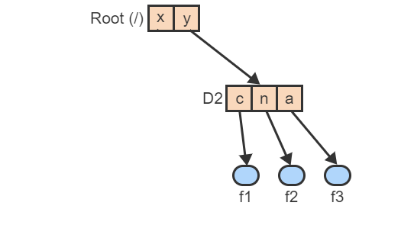
TSDH – Visualized – 2
File y is the ASCII name of the directory with the internal ID D2 at the next lower level. D2 points to 3 files, f1-f3, with the user names c, n, and a

Slide 18
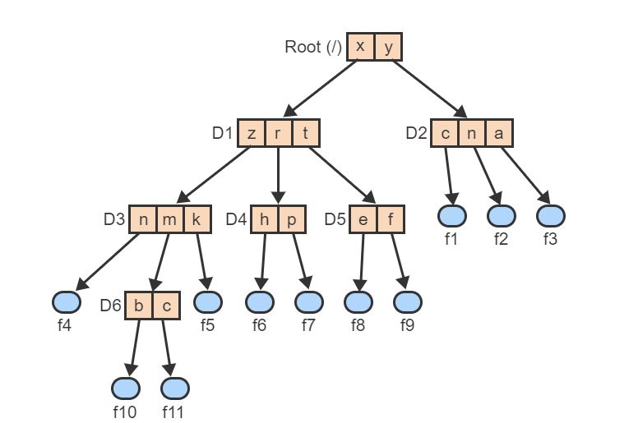
TSDH – Visualized – 3
File x is the name of the directory D1, which points to 3 lower-level directories, D3-D5. Each of these directories points to still lower-level files and directories

Slide 19
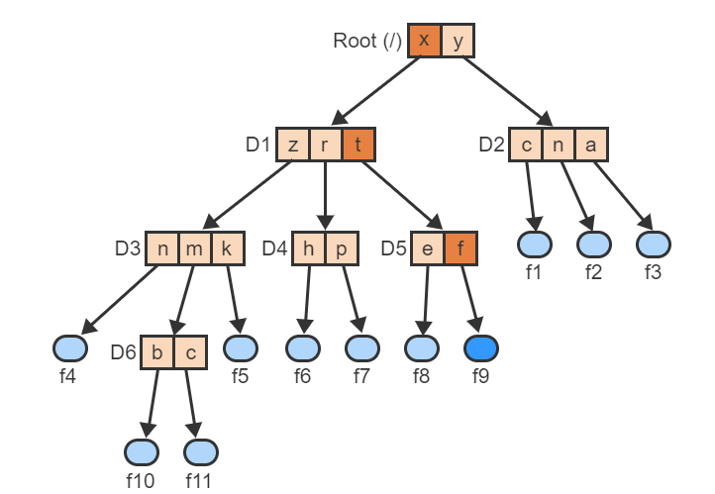
TSDH – Visualized – 4
The absolute path name /x/t/f uniquely identifies the file named f in directory D5. The file's internal ID is f

Slide 20
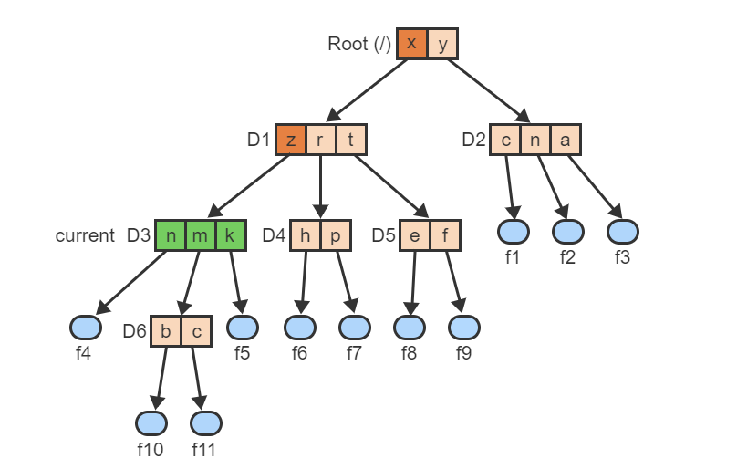
TSDH – Visualized – 5
The directory D3, identified by the path name /x/z, is designated as the current working directory

Slide 21
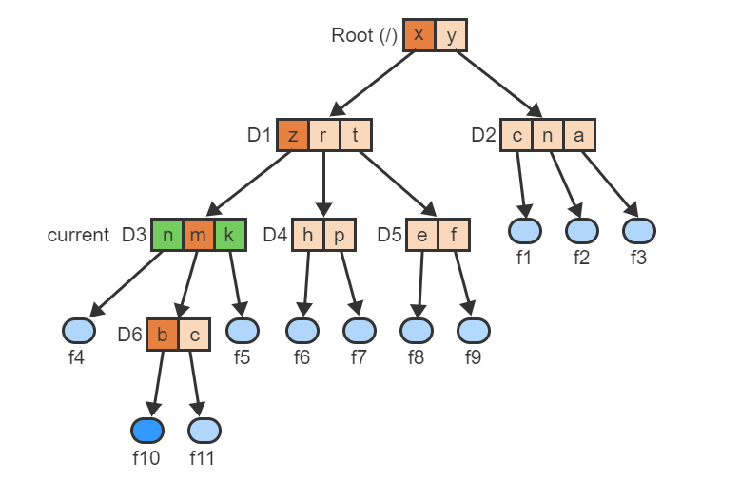
TSDH – Visualized – 6
With the current working directory, the pathname m/b identifies the same file f10 as the absolute path name /x/z/m/b

Slide 22
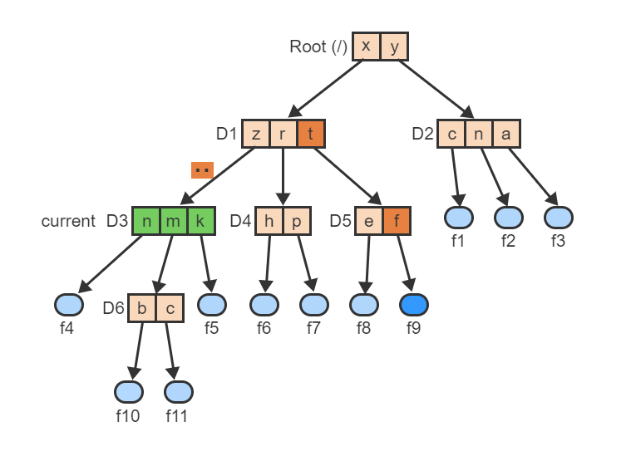
TSDH – Visualized – 7
To refer to a file that is not in the subtree rooted in the current directory, the notation ".." is used to go to the next higher level. The path name ../t/f refers to file f9

Slide 23
Operations on Directories
The FS provides a set of operations to allow the user to manipulate and use the directory hierarchy.
The specific syntax and semantics of the operations vary between different OSs but the following (next slide) is a generic set representative of most modern OSs.

Slide 24
Operations on Directories
Operation | Description
Change | Change the current working directory to another directory specified by a path name.
Create | Create a new named directory and a new entry in the current working directory, which points to the new directory.
Delete | Delete directory d specified by a path name. Delete also all files and directories reachable using any path name starting from d.
Move | Move a file or directory from one directory to another.
Rename | Change the name of a file or directory specified by a path name.
List | List the file names and optionally other attributes of all files contained in a directory specified by a path name.
Find | Find a file or directory specified by a name.

Slide 25
Operations on Directories → CentOS
Operation | Description
Change | cd
Create | mkdir
Delete | rm -f -r directoryName (if directory contains files), rmdir directoryName (if directory is empty)
Move | mv /path/to/source /path/to/dest
Rename | mv OriginalDirectoryName DesiredDirectoryName
List | ls
Find | find / -type d -name “DirectoryName" please note that ‘/‘means find within root.

Slide 26
Directed Acyclic Directory Structure
The main drawback of a tree-structured directory hierarchy is that file sharing is asymmetric.
Only one directory can be the parent of any file or another directory.
Other users must refer to the file by first navigating up to a common directory and then down to the desired location.
A directed acyclic directory hierarchy organizes directories such that any directory at a given level may point to zero or more files or other directories at lower levels but also permits any file or directory to have more than one parent directory.
To permit the creation of multiple parents, the FS provides an additional operation of the form "link path1 path2", which creates a new link from the directory identified by the path name path1 to the directory or file identified by path2.

Slide 27
Directed Acyclic Directory Structure
Since any file, including any directory, can now be pointed to by more than one directory, the semantics of file deletion must be extended.
A reference count is a non-negative integer associated with a file f, which indicates how many directories are pointing to the file.
The file is deleted only when the reference count is 1, indicating that f has only a single parent directory.
Otherwise only the pointer to f is deleted from the parent directory and the reference count of f is decremented.

Slide 28
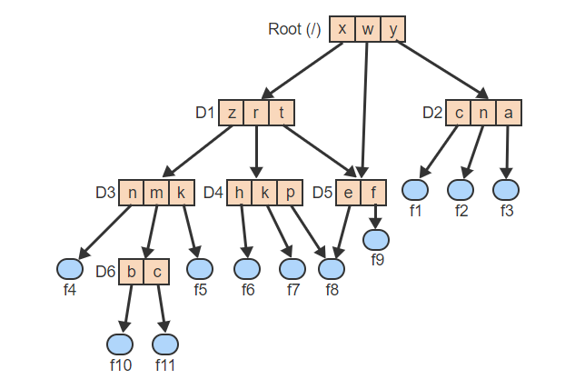
DADS – Visualized – 1
Directory D5 has 2 parents: D1 and Root. File f8 also has 2 parents: D4 and D5

Slide 29
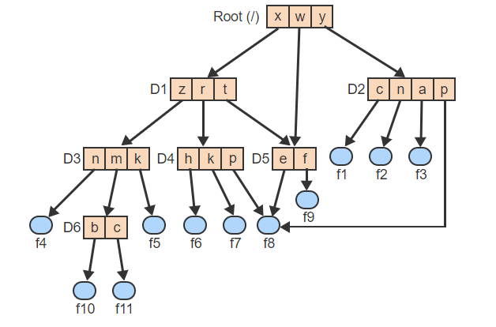
DADS – Visualized – 2
The operation "link /y/p /w/e" creates a new entry named p in directory D2. The entry points to file f8, which now has 3 parents: D4, D5, and D2

Slide 30
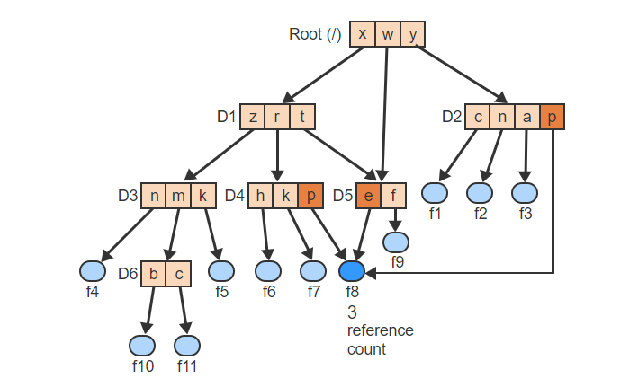
DADS – Visualized – 3
Since file f8 is shared equally by 3 directories, the associated reference count is 3

Slide 31
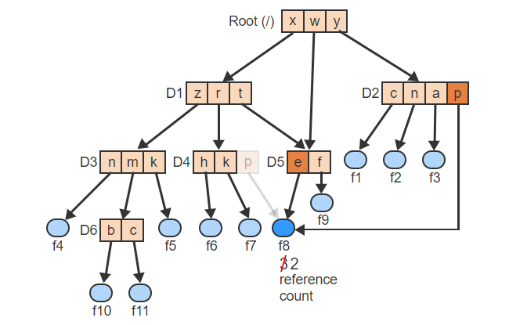
DADS – Visualized – 4
Deleting f8 using the path name /x/r/p does not remove the file but only removes the entry from the parent directory D4 and decrements the reference count

Slide 32
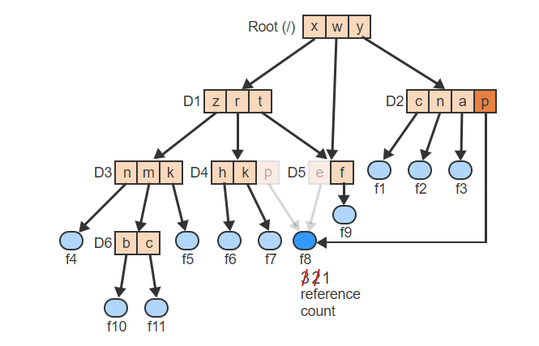
DADS – Visualized – 5
Similarly, deleting the file using the path name /w/e only removes the entry from the parent directory D5 and again decrements the reference count

Slide 33
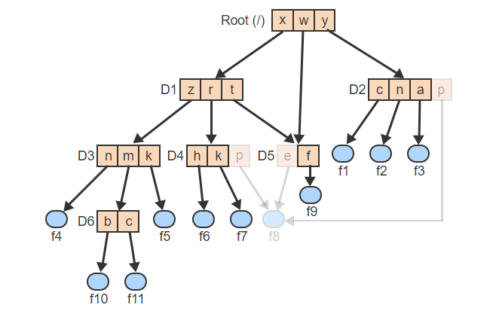
DADS – Visualized – 6
Since the reference count of f8 is now 1, deleting the file using the last remaining path name /y/p removes both the directory entry p from D2 and the file itself

Slide 34
Graph Structure with Symbolic Links
A Directed Acyclic Directory Structure has some problems!
If a directory can point to a file or another directory at a higher level, then a cycle can form in the hierarchy.
A cycle, if undetected, can lead to an infinite loop in algorithms that search the hierarchy for a given file.
File deletion also becomes more difficult. A reference count is not sufficient to prevent the creation of unreachable subgraphs in the directory hierarchy, which can only be removed using a garbage collection algorithm.

Slide 35
Graph Structure with Symbolic Links
A compromise solution is to allow only a single parent directory for any file or directory but to provide symbolic links to support file sharing.
A symbolic link (or shortcut) is a directory entry that points to a file or directory just like a regular entry but is treated differently with respect to deletion.
A delete operation only removes the link but not the file itself.

Slide 36
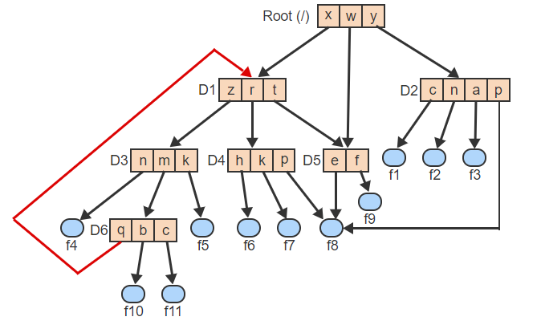
Symbolic Links – Visualized – 1
When a directory is allowed to point to a file or another directory at a higher level, a cycle forms in the hierarchy

Slide 37
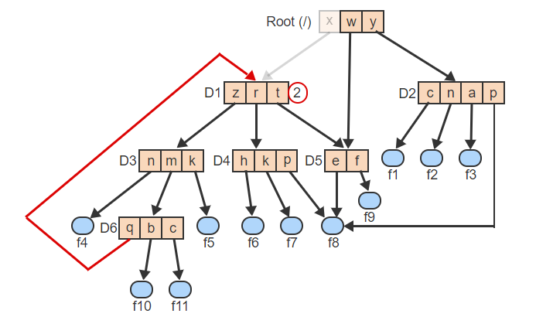
Symbolic Links – Visualized – 2
When cycles are present, reference counts are insufficient to guarantee proper deletion. When /x is to be deleted, the count is 2 and so only the link x is deleted

Slide 38
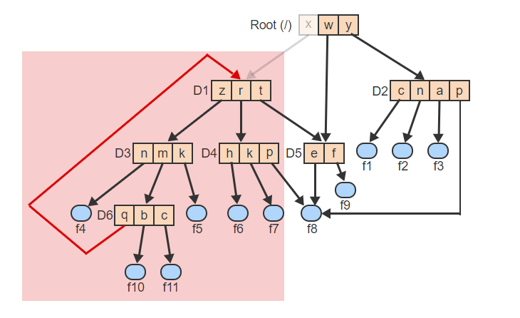
Symbolic Links – Visualized – 3
However, the 4 directories D1, D3, D4, and D6, and many of the files are no longer reachable from the root. A garbage collection algorithm is needed to remove the subtree

Slide 39
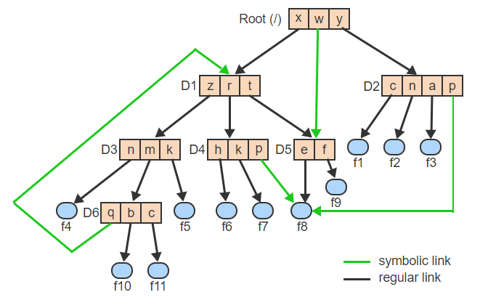
Symbolic Links – Visualized – 4
With symbolic links, every file and every directory has exactly one parent

Slide 40
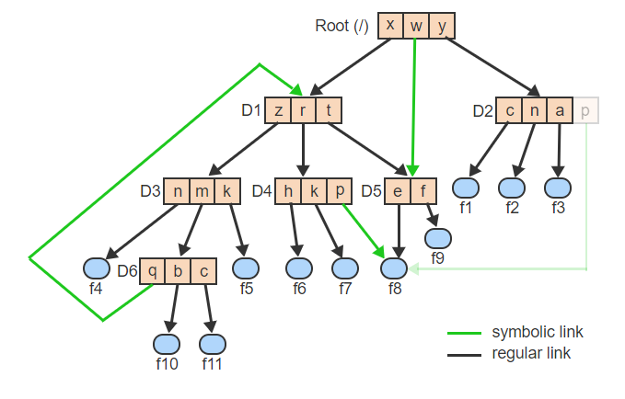
Symbolic Links – Visualized – 5
Deleting /y/p removes only the symbolic link but not the file f8 itself

Slide 41
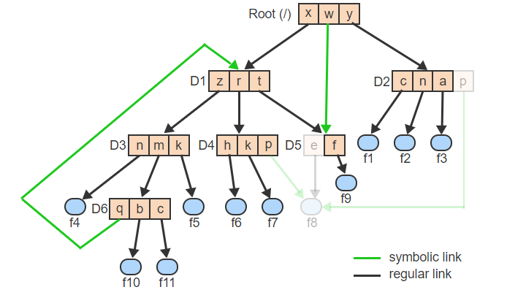
Symbolic Links – Visualized – 6
On the other hand, deleting /x/t/e removes the directory entry e as well as the file f8

Slide 42
File Directory Implementations
In addition to a file's name, data, and metadata, the FS must keep track of various attributes necessary for accessing the file and for providing relevant information to the user. The typical file attributes include:
Size: The current size in bytes or words.
Type: Information to differentiate directories, regular files, executable files, and other types of files supported by the system.
Location: Information necessary to locate the file's physical blocks on disk.
Protection: Information about who can access the file and the permitted type of access (e.g., read only or execute only).
Use: The date and time of file creation, last access, or last modification.

Slide 43
File Directory Implementations
Where to keep file attributes is an important design issue.
One approach is to keep all attributes together with the file name inside each file directory.
The main drawback is that file directories can become very long, which slows down the search.
Another approach is to keep only the file name inside the directory and provide a pointer to a separate data structure to store the file attributes.
A File control block (FCB) is a data structure associated with a filename that contains all relevant attributes of the file.
FCBs are stored apart from file directories and are pointed to by the corresponding directory entries.
In Unix and other OSs an FCB is called an i-node.

Slide 44
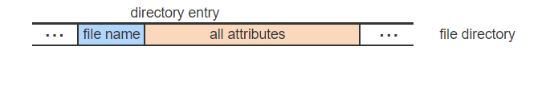
Directory Entries – Visualized – 1
A directory entry can include all attributes associated with a file

Slide 45
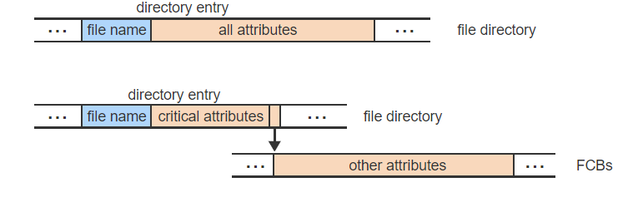
Directory Entries – Visualized – 2
To reduce the size of a directory entry and increase the search speed, only the critical attributes may be kept in the directory. All others are kept as FCBs in a separate area accessed by a pointer

Slide 46
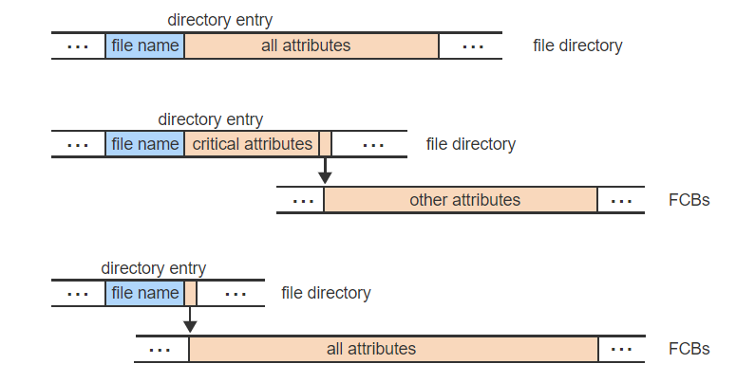
Directory Entries – Visualized – 3
In the extreme, only the file name is kept in the directory. All attributes are kept as FCBs in a separate area and are accessed via a pointer from the directory entry

Slide 47
Keeping Track So Far
RCB
PCB
PCB can also mean Polychlorinated biphenyl or printed circuit board 😂
TCB
FCB
On the plus side the exam is open book!

Slide 48
Internal Structure of File Directories
The FS must be able to efficiently
Search directories for a file name,
Find and allocate an entry when a new file is created,
Free an entry when a file is deleted,
And change the file name, which may shorten or lengthen the name length.
Several approaches exist to organizing directory entries.

Slide 49
Organizing Directory Entries – 1
The directory is an array with fixed-length entries. Each entry contains a valid file name or is free.
Finding, freeing, or allocating entries is simple because all have the same size.
Main drawback: All file names have a maximum length.

Slide 50
Organizing Directory Entries – 2
The directory is an array with variable-length entries. Each entry contains a length field and either a valid file name or is free.
Searching for a file name or a hole is accomplished by following the length fields.
Deleting a file requires coalescing the newly free entry with any free neighboring entries to prevent fragmentation.
Changing the file name length requires freeing the current entry and allocating a new entry to reflect the new name length.

Slide 51
Organizing Directory Entries – 3
The directory is an array with variable-length entries.
Each entry contains a valid file name, followed by a possibly empty hole. Each entry also contains two pointers, one pointing to the end of the entry and the second to the end of the file name.
Finding, freeing, or allocating entries is analogous to implementation 2.
The main advantage is that, in most cases, changing the file name length only requires adjusting the second pointer. A new entry must be allocated only when the new length exceeds the end of the hole.

Slide 52
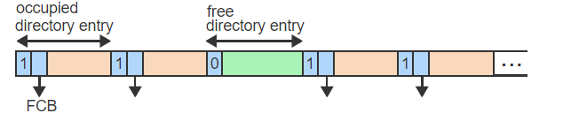
Directory Organization – Visualized – 1
The simplest directory organization is an array of fixed size entries. Each entry is either occupied (1) or free (0). An occupied entry points to an FCB containing all attributes

Slide 53
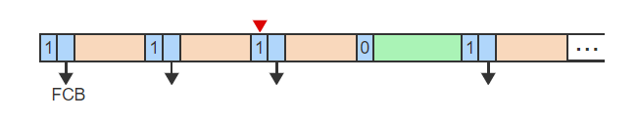
Directory Organization – Visualized – 2
Search for a file name or a hole is done by repeatedly advancing a pointer by the entry size. Allocating or freeing an entry only requires changing one bit. But file names are limited by entry size

Slide 54
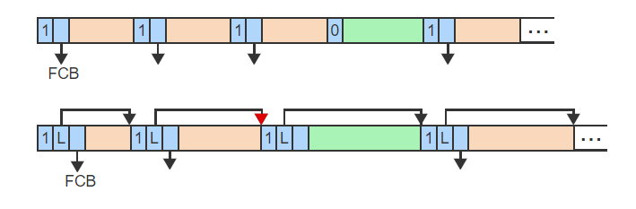
Directory Organization – Visualized – 3
To allow variable length file names, each entry contains the entry's length L. Searching for a file name or a hole uses L to repeatedly advance to the next entry

Slide 55
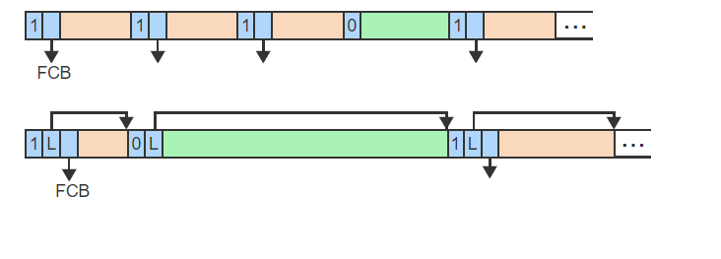
Directory Organization – Visualized – 4
Freeing an entry changes the tag from 1 to 0 and may require coalescing with a neighboring hole by changing the pointer

Slide 56
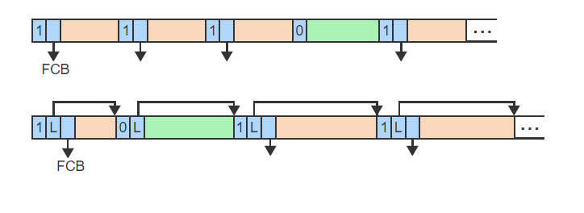
Directory Organization – Visualized – 5
Creating a new file requires a search through the list for a large enough hole and allocating a portion of the hole to the file. Changing the file name length also results in moving the entry to a new hole

Slide 57
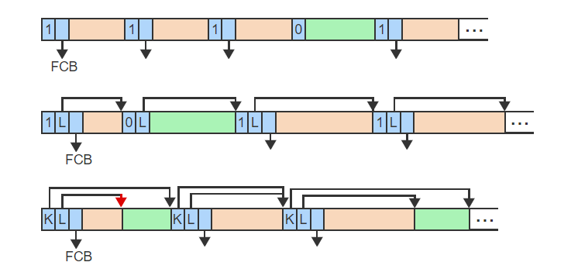
Directory Organization – Visualized – 6
The third approach includes a hole, possibly of size 0, as part of each entry. Two pointers, K and L, indicate the end of the entry and the end of the file name, respectively

Slide 58
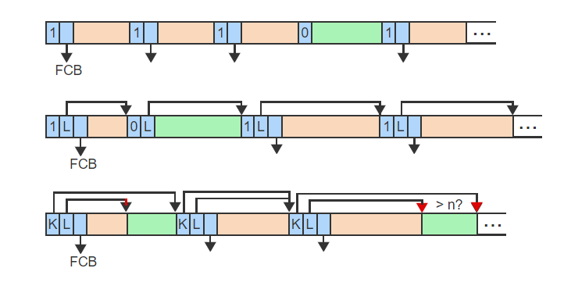
Directory Organization – Visualized – 7
Searching for a file name or a hole of size >n requires advancing the pointer by K. A hole size is given by K - L. Freeing or allocating an entry is just like the previous case

Slide 59
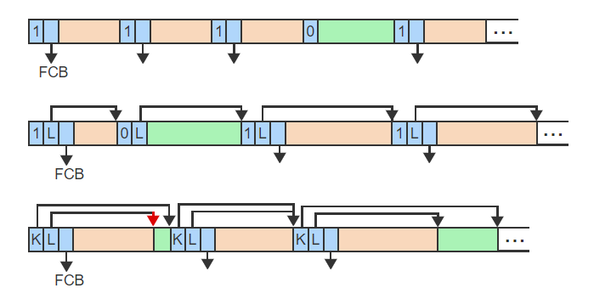
Directory Organization – Visualized – 8
The main advantage is that a file name length can easily be changed by moving the L pointer

Slide 60

Operations on Files
Create File: The create file operation causes the creation of new named file.
Destroy File: The destroy file operation removes an existing file from the FS.
I just thought it would be cool to include a zip file picture, it has not relation to the slide.

Slide 61
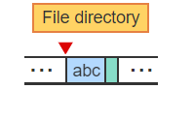
Create/Destroy – Visualized – 1
To create a new file, the FS searches the directory for a match to avoid duplicates. If no match is found, the FS allocates a free entry and enters the file name, abc.

Slide 62
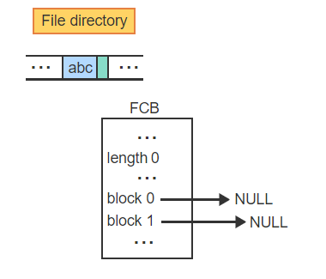
Create/Destroy – Visualized – 2
The FS allocates a new FCB and initializes the attributes. The file is empty and thus length is 0 and all pointers to disk blocks are NULL

Slide 63
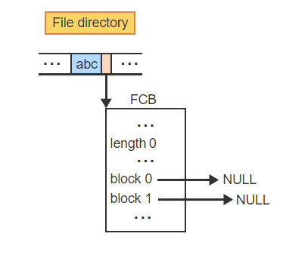
Create/Destroy – Visualized – 3
The directory entry is set to point to the FCB, which completes the creation of the file

Slide 64
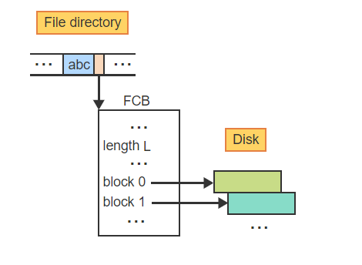
Create/Destroy – Visualized – 4
When a file has been written into, some of the FCB entries point to valid blocks on the disk. The file length L is then greater than 0

Slide 65
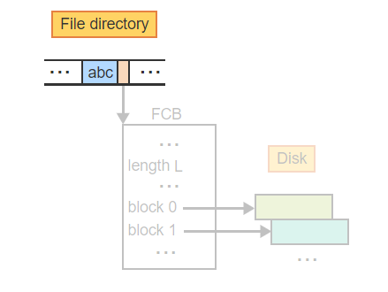
Create/Destroy – Visualized – 5
To destroy a non-empty file, the FS releases the file's disk blocks and the FCB

Slide 66
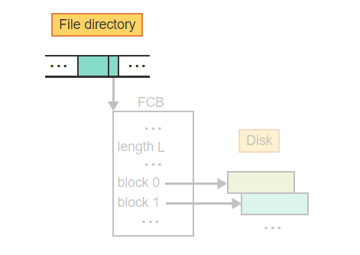
Create/Destroy – Visualized – 6
Finally, the directory entry is marked as empty, which completes the destruction of the file

Slide 67
Opening Files
The open file table (OFT) is a data structure that keeps track of all files currently in use to facilitate efficient access to and manipulation of the files.
The open file operation prepares a file for efficient access and manipulation by retrieving relevant file information from the FCB and storing the information in an entry of the OFT.

Slide 68
Reading/Writing/Seeking/Closing Files
A read file operation copies data from an open file to a specified area in main memory.
A write file operation copies data from an area in main memory to a specified open file.
A seek operation moves the current position of an open file to a new specified position.
The close file operation reverses the effects of the open operation by saving the current state of the file in the FCB and freeing the OFT entry.

Slide 69
Summary
What is an FCB?
Why do we utilize this data structure?
What are some ways we can organize/structure file directories?
What is an FS?

